Slide 1
MACHAKOS UNIVERSITY
SCHOOL OF ENGINEERING AND TECHNOLOGY
DEPARTMENT OF COMPUTING AND INFORMATION TECHNOLOGY
BSC. COMPUTER SCIENCE
SCO405: COMPRESSION TECHNIQUES
GROUP D MEMBERS
BERYL MURONJI J17-1031-2018
JACKSON KIMANI J17-1011-2018
CALEB OMOLLO J17-1047-2018
DENNIS MUTWIRI J17-1015-2018

Slide 2
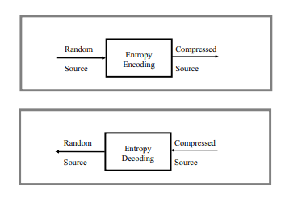
a) By using examples in each case, distinguish between entropy coding, source coding and channel coding compression techniques
Entropy coding is a lossless data compression scheme that is independent of the specific characteristics of the medium. Replaces data elements with coded representations.
Entropy coding creates and assigns a unique prefix code to each unique symbol that occurs in the input. The data is then compressed by replacing each fixed-length input symbol by the corresponding variable-length prefix codeword.
Uses Shannon's source coding theorem, i.e. the optimal code length for a symbol is log_{b}P, where b is the number of symbols used to make output codes and P is the probability of the input symbol.
Examples of entropy coding include Huffman coding and arithmetic coding

Slide 3
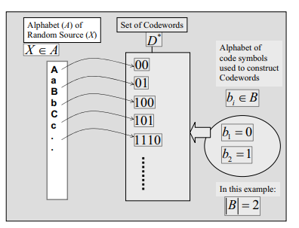
Generally, entropy coding is achieved by designing a code, C, which provides a one-to-one mapping from any possible outcome a random variable, X (“source”) to a codeword .
There are two alphabets in this case; one alphabet is A of the random source X and alphabet B used for constructing the codewords. Based on B, we can construct and define the set D*, which is the set of all finite-length string of symbols withdrawn from the alphabet B.
The most common and popular codes are binary codes, where the alphabet of the codewords is simply the binary bits 0 and 1.

Slide 4
Source Coding
Attempts to remove unwanted redundancy from the data from a source in order to transmit it more efficiently. For example, Zip Data compression makes data files smaller, for purposes such as to reduce Internet traffic.
It is more like quantizing and run length coding. where in you can send a code like '05'(zero five)which symbolizes five zeros at a stretch instead of sending 00000.
Example is Lempel-Ziv coding
Channel Coding
Adds useful redundancy to the data from a source to make the transmission more robust to disturbances present on the transmission channel. i.e. We add ( append ) extra bits with data in channel coding to protect information from errors and for crosschecking of received information.
It is performed both at the receiver and the transmitter.
Examples include repetition codes-send each data bit three times. The receiver examines the three transmissions and decides by majority vote whether a 0 or 1 represents a sample of the original signal.
Hamming code -This code is able to protect a four-bit information signal from a single error on the channel by adding three redundant bits to the signal.
Convolutional codes- convert the entire data stream into one single codeword.

Slide 5
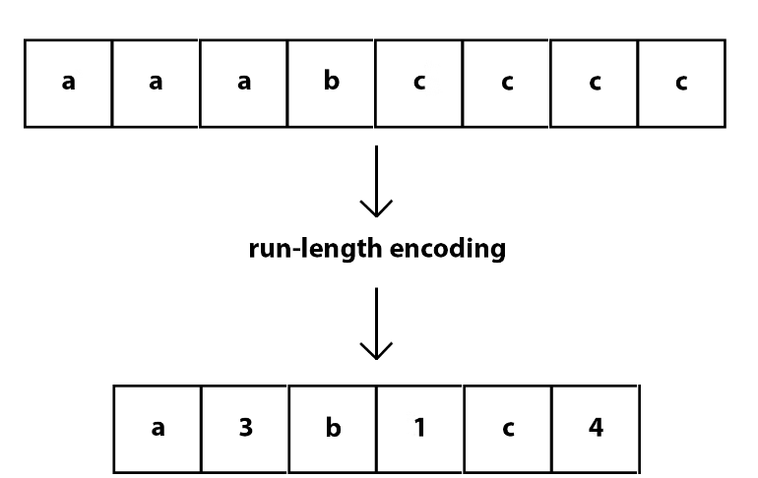
b) Discuss how Run-Length coding, Differential Pulse Code Modulation (DPCM) and Wavelet compression techniques work.
Run Length Coding
A lossless compression method where sequences that display redundant data are stored as a single data value representing the repeated block and how many times it appears in the image. Later, during decompression, the image can be reconstructed exactly from this information.

Slide 6
Example2:
000000111111111111110000000000000111111111
000000 11111111111111 0000000000000 111111111
6 0-bit 14 1-bits 13 0-bits 9 1-bits
Original size = 42 bits
Encoding
0:6 1:14 0:13 1:9
resulting 5 bit bytes
00110, 11110, 01101, 11001
3) compressed bit stream
00110111100110111001
Size of the compressed = 20bits

Slide 7
Wavelet Compression
Technique used to compress video and audio signals. works best for compressing high-contrast images and short-duration audio.
This technique uses wavelet transforms to gather the necessary information about the file. The resulting file can be either lossless, meaning it is as good as the original, or lossy, meaning some information has been lost.
An example of this in use is when compressing an image, the entire image is treated as a series of wavelets. Wavelets are changes from pixel to pixel as measured by the deviation of an individual pixel from zero. The distance of the deviation is recorded as a coefficient, a whole number that measures some property or characteristic. In this case, the coefficient measures the color of the pixel. The process of measuring and recording the coefficients of the pixels is called a wavelet transform.

Slide 8
At this stage in the wavelet compression, no compression has yet taken place. The image has just been translated into a form that the computer can work with. Instead of a color image, the computer now has a series of numbers. The next step in wavelet compression is a decomposition.
During decomposition, the coefficients of adjacent pixels are averaged. Averaging produces a simplified version of the wave, making the description of the image smaller. This process is repeated until the image is fully compressed. The more times the process is repeated, the smaller the data file can be and the quicker the file will be to transmit.
The final size of the compressed file depends not just on the size of the original file, but also on the desired quality of the final product.
The final result can be lossy where as a file is decompressed the information that the computer deems unnecessary is thrown away to allow the file to get smaller i.e. lossy compression, and it results in a file that is not quite as good as the original.

Slide 9
Wavelet compression can also use a lossless method, in which no information is thrown away. This results in a compressed file that, when decompressed, is exactly the same quality as the original file.
Differential Pulse Code Modulation (DPCM)
This is a technique used in analog to digital signal conversion.
Samples the analog signal and then quantizes the difference between the sampled value and its predicted value, then encodes the signal to form a digital value.
Works on the principle of prediction. The value of the present sample is predicted from the previous samples. The prediction may not be exact, but it is very close to the actual sample value.

Slide 10
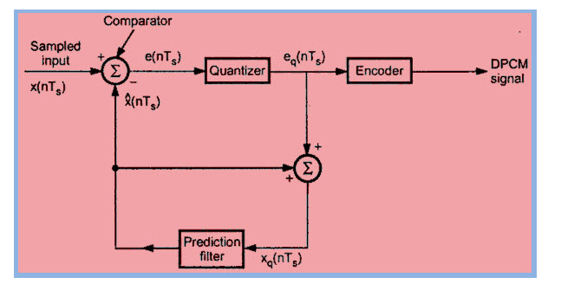
Differential Pulse Code Modulation Transmitter
The transmitter consists of a comparator, quantizer, prediction filter, and an encoder.
The sampled signal is denoted by x(nTs) and the predicted signal is indicated by x^(nTs). The comparator finds out the difference between the actual sample value x(nTs) and the predicted value x^(nTs). This is called signal error and it is denoted as e(nTs)

Slide 11
e(nTs)= x(nTs)- x^( nTs) …….(1)
Here the predicted value x^(nTs) is produced by using a prediction filter(signal processing filter).
The quantizer output signal eq(nTs) and the previous prediction is added and given as input to the prediction filter, this signal is denoted by xq(nTs). This makes the prediction closer to the actually sampled signal. The quantized error signal eq(nTs) is very small and can be encoded by using a small number of bits. Thus the number of bits per sample is reduced in DPCM.
The quantizer output would be written as,
eq(nTs)= e(nTs)+ q(nTs) ……(2)
Here q(nTs) is quantization error. From the above block diagram the prediction filter input xq(nTs) is obtained by sum of x^(nTs) and the quantizer output eq(nTs).
i.e, xq(nTs) = x^(nTs)+ eq(nTs).………. (3)

Slide 12
by substituting the value of eq(nTs) from the equation (2) in equation (3) we get, xq(nTs) = x^(nTs)+ e(nTs)+ q(nTs)……. (4)
Equation (1) can written as,
e(nTs)+ x^( nTs) = x(nTs)……. (5)
from the above equations 4 and 5 we get,
xq(nTs) = x(nTs)+ q(nTs)
Therefore, the quantized version of signal xq(nTs) is the sum of original sample value and quantized error q(nTs). The quantized error can be positive or negative. So the output of the prediction filter does not depend on its characteristics.

Slide 13
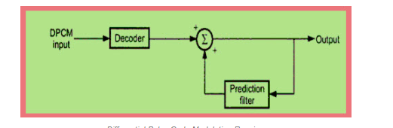
Differential Pulse Code Modulation Receiver
In order to reconstruct the received digital signal, the DPCM receiver consists of a decoder and prediction filter. In the absenteeism of noise, the encoded receiver input will be the same as the encoded transmitter output.
Decoder will reconstruct the quantized form of the original signal. Therefore the signal at the receiver differs from the actual signal by quantization error q(nTs), which is introduced permanently in the reconstructed signal.

Slide 14
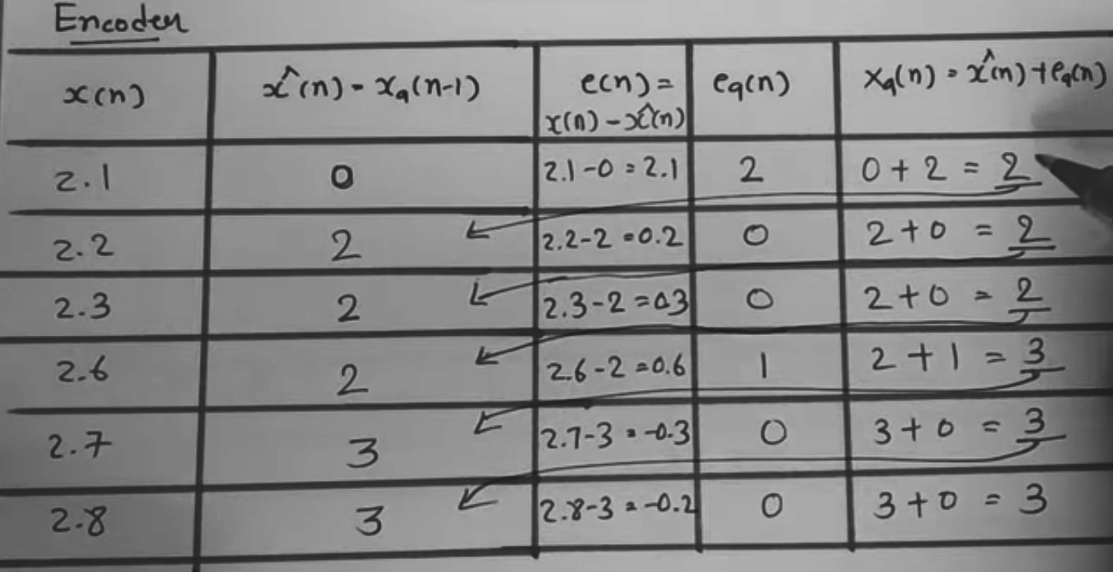
Example: X(n) = {2.1,2.2,2.3,2.6,2.7,2.8}
Eq(n) = quantized error signal
Will be the transmission signal translated to digital data
DPCM Digital Data
3bit = 010 000 000 001 000 000

Slide 15
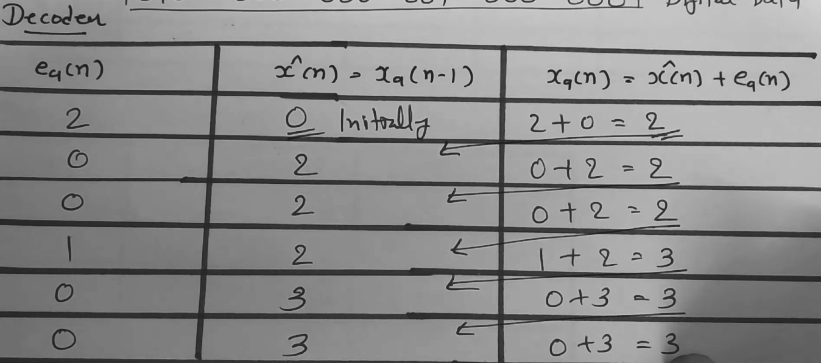
Input signal from the transmitter:
200100
Received signal from the decoder:
{2,2,2,3,3,3}

Slide 16
c) For the sequence below; construct Lempel-Ziv parsing and explain how the code will be encoded by Lempel_Ziv code.
0101101011101101110111
Assuming that the input alphabet is {0,1}
Then the decomposition phrase is as follows
|0|1|01|10|101|11|011|0111|0111.
The outcome list of reference –alphabet pairs:
0,0 0, 1 1, 1 2, 0 4, 1 2, 1 3, 1 7, 1 7.
Note: The last phrase has no alphabet part, simply because it is a repeated phrase.
Upon encoding dictionary reference with the correct number of bits outputs the following.
0 01 011 100 1001 0101 0111 1111 0111.

Slide 17
Lempel-zip Coding
The LZW algorithm is a compression technique. This algorithm is typically used in GIF (Graphics Interchange Format) and optionally in PDF (Portable Document Format) and TIFF(Tag Image File Format). Unix’s ‘compress’ command, among other uses. It is lossless, meaning no data is lost when compressing.
Example
Encode the following data sequence 000101110010100101
Steps
Divide given data into segments.
Segments should be the shortest sequence and should not have been encountered previously.
Segments are referred to as phrases.
We encode a phrase by considering prefix (numerical value) and last bit (digital data usually 0 and 1).
00 01 011 10 010 100 101 these are the segments from the sequence above
Position | 1 | 2 | 3 | 4 | 5 | 6 | 7 | 8 | 9
Sequence | 0 | 1 | 00 | 01 | 011 | 10 | 010 | 100 | 101
Numerical Rep. | 1 | 2 | 1 1 | 1 2 | 4 2 | 2 1 | 4 1 | 6 1 | 6 2
Digital encoded data | 0 | 1 | 10 | 11 | 1001 | 100 | 1000 | 1100 | 1101

Slide 18
d) Consider the simple encoding scheme which simply repeats every bit of the input 3 times, and decoded by taking the majority vote.
Calculate the rate of this encoding scheme.
The encoding rate is 1/3 ( A third)
Suppose a message of length k is encoded and sent through a binary symmetric channel which flips each bit with probability p. Determine the probability that a message sent using this encoding scheme is decoded correctly.
Consider any block of 3 bits corresponding to a single bit of the input. The probability that it gets decoded correctly is the probability that at most 1 of the bits is flipped, i.e., (1 - p)³ + 3p(1 - p)². The probability that each of the blocks corresponding to each bit of the input is decoded correctly is thus ((1 - p)³ + 3p(1 - p)²)^{k}.
Suppose p = 0:125. Is it true that for k (the message length) large enough, there exists an encoding scheme with the same rate as the above simple encoding scheme and which decodes correctly with a probability of at least 99%? Explain why or why not.
The entropy of the source is H(p) = -1/8 log₂( 1/8 )-78 log₂( 7/8 ) == 0.377 <0.5. Thus the channel capacity is at least 1 - H(p) 0.5. Thus 1/3 is above the capacity, and by Shannon's theorem there exist good codes with the required property.
End of Assignment

